Slide 1
Making Music With Arduino
The MIDI Protocol
Gustavo Silveira

Slide 2
MIDI
Musical Instrument Digital Interface.
Communication between electronic music instruments, computers and a variety of other related devices.
It carries a series of information, such as: Note on, note off, velocity, pitch bend, modulation…

Slide 3
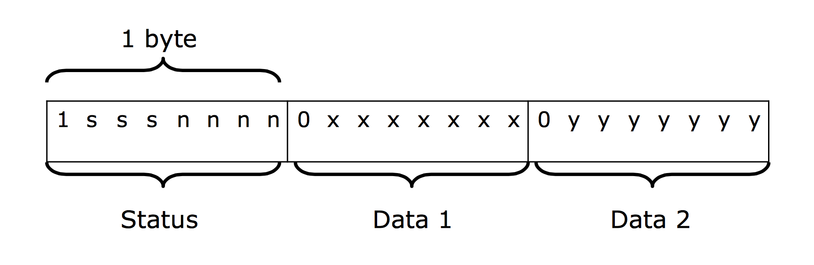
Midi Code: The Message Format
1 byte – 8 bit resolution.
2 types of MIDI message bytes: the status byte and the data byte.
Status bytes always begins with 1, and data bytes with 0. That leaves only 7 bits per byte to represent the message (128 possible values).
MIDI messages begin with the status byte, where 3 bits (sss) are used to indicate the type of message, and 4 bits (nnnn) to indicate the channel number to which the message applies (max. 16 channels).

Slide 4
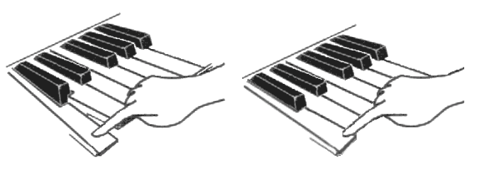
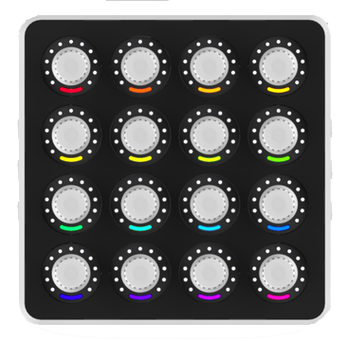
Types of messages
Message | Status | Data 1 | Data 2
Note off | 8n | Note number | Velocity
Note on | 9n | Note number | Velocity
Control change | Bn | Controller number | Data
Note On
Note off
Control controller

Slide 5
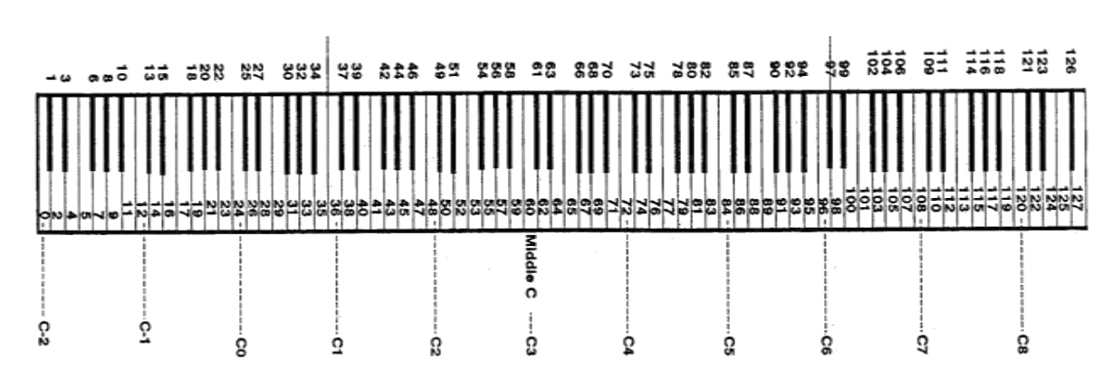
Note on / Note off
There are 128 (0-127) possible notes (10 octaves) mapped to the occidental chromatic scale.
Normally, the central C is mapped to the MIDI C3, note number 60, sixth octave.

Slide 6
Midi CC (control change)
MIDI also can be used to send data through other kinds of controllers, like pedals, switches, knobs, etc, through MIDI CC.
There is a total of 128 (0-127) MIDI CCs available, and a lot of them already come mapped into certain controls, like: : CC 1 (modulation wheel); CC 7 (volume); etc.
Here it is a complete list with the numbers of the MIDI CCs.

Slide 7
References:
BELLO, Juan P. MIDI Code.

